Slide 1



Data Analytics
Unit 3 - SQL joins, Sub Queries, ML- Classification, Regression
NOV 2020 | BERLIN

Slide 2

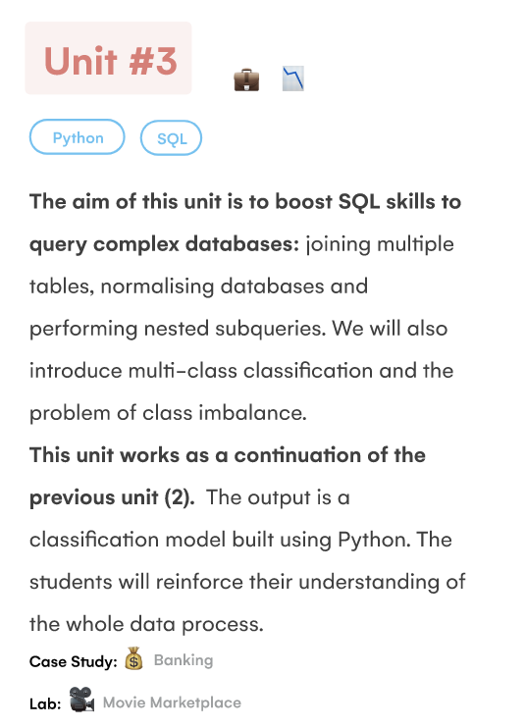
What will I learn in this unit?

Slide 3
What will I learn in this unit?
Objectives / concerns
Switching to online --- concerned how this is going to go
practicalities , working from home
Query about the data clean project ?
Working with python and ML - nervous about gaps in knowledge from first week - jupyter notebooks shared
HAVING
WINDOW FUNCTIONS

Slide 4
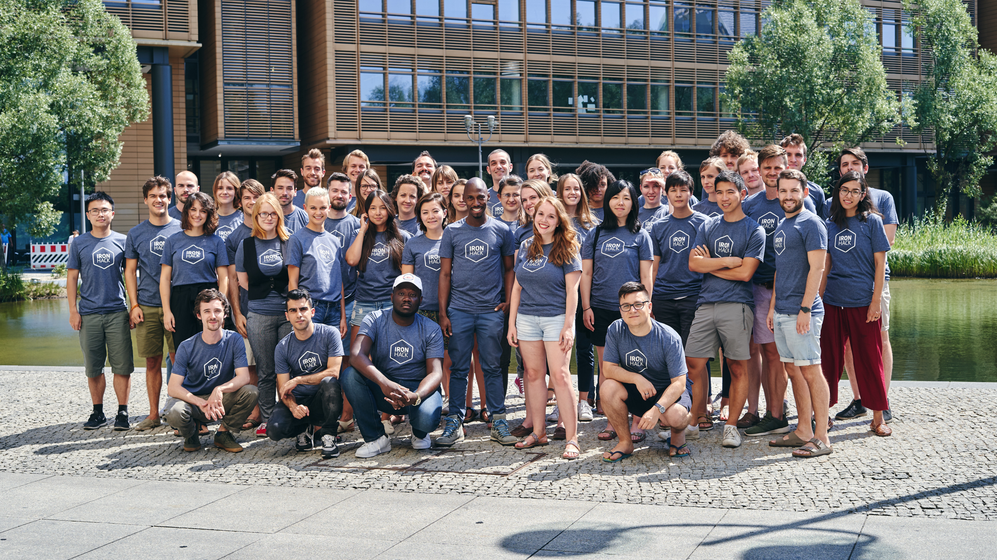

Fun day - Monday

Slide 5

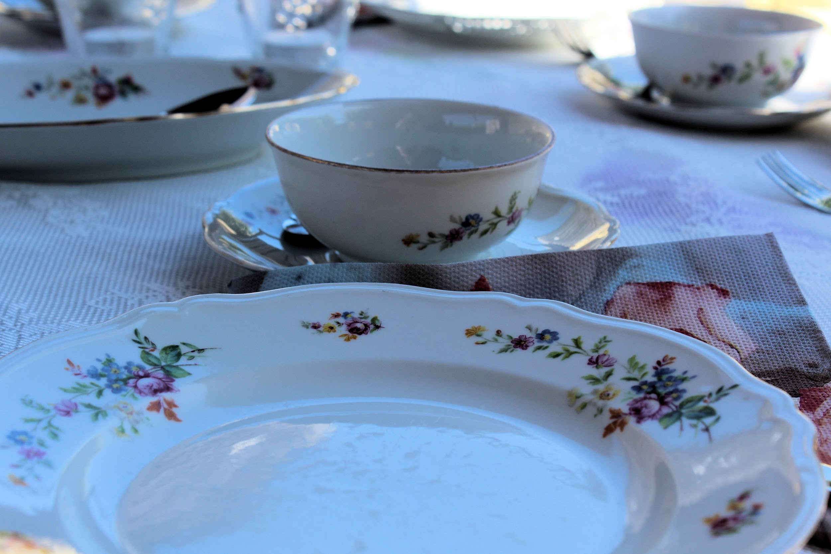

Morning session
Afternoon Session
Lab Session
The Best of - class challenge from this morning
Keys, Cardinality
BOG - Planning a Join query
Joins - multiple tables (2+)
SQL Logical processing order review
-Chair yoga break
-fresh air break 20 mins
Guide for Zoom learning
Class NoticeBoard
Review Section
Review challenge - Sian’s example,
Students try
-mid morning break 20 mins
Using Bank data:
SQL Joins, LEFT, RIGHT
-lunch 12:30- 1:30
->TA assisted Lab Groups 16:00-
Catch up on UNIT 2 Labs 1-9
Review and update missing submissions on student portal
SQL Logical processing order
Unit 3 Labs:
Lab SQL Join
Stretch - Lab SQL Join multiple tables ; continue working on this morning’s review challenge with Python + SQL
Notes:
Tomorrow
More on joins multiple tables
Stretch lecture:
- self joins and cross joins
QL comfort zone - class quiz /kahoot
Stretch : Lab SQL Self and Cross join
Using temporary tables
BOG - SQL views /stored procedures

Slide 6

Lets start with...
REVIEW
Connect to MariaDB online
Select a database
Launch jupyter notebook
Connect to the DB via Python
Create a dataframe from the DB using SQL queries and pandas
Visualise the df in Python using Seaborn or MatplotLib
Choose visualisation(s) which answer your data question(s)

Slide 7
Example : What are we trying to find out?
World database contains information about 239 countries
We want to see the density of the population per sq km
What are the top 25 most dense countries?
Excluding any zero/unknown values
What are the capitals of those countries?
Which capitals have the biggest proportion of the country population ?
Can we reasonably infer capital city population based on country population density?

Slide 8

“Above all else, show the data.” – Edward R. Tufte

Slide 9

Two Day - Tuesday

Slide 10
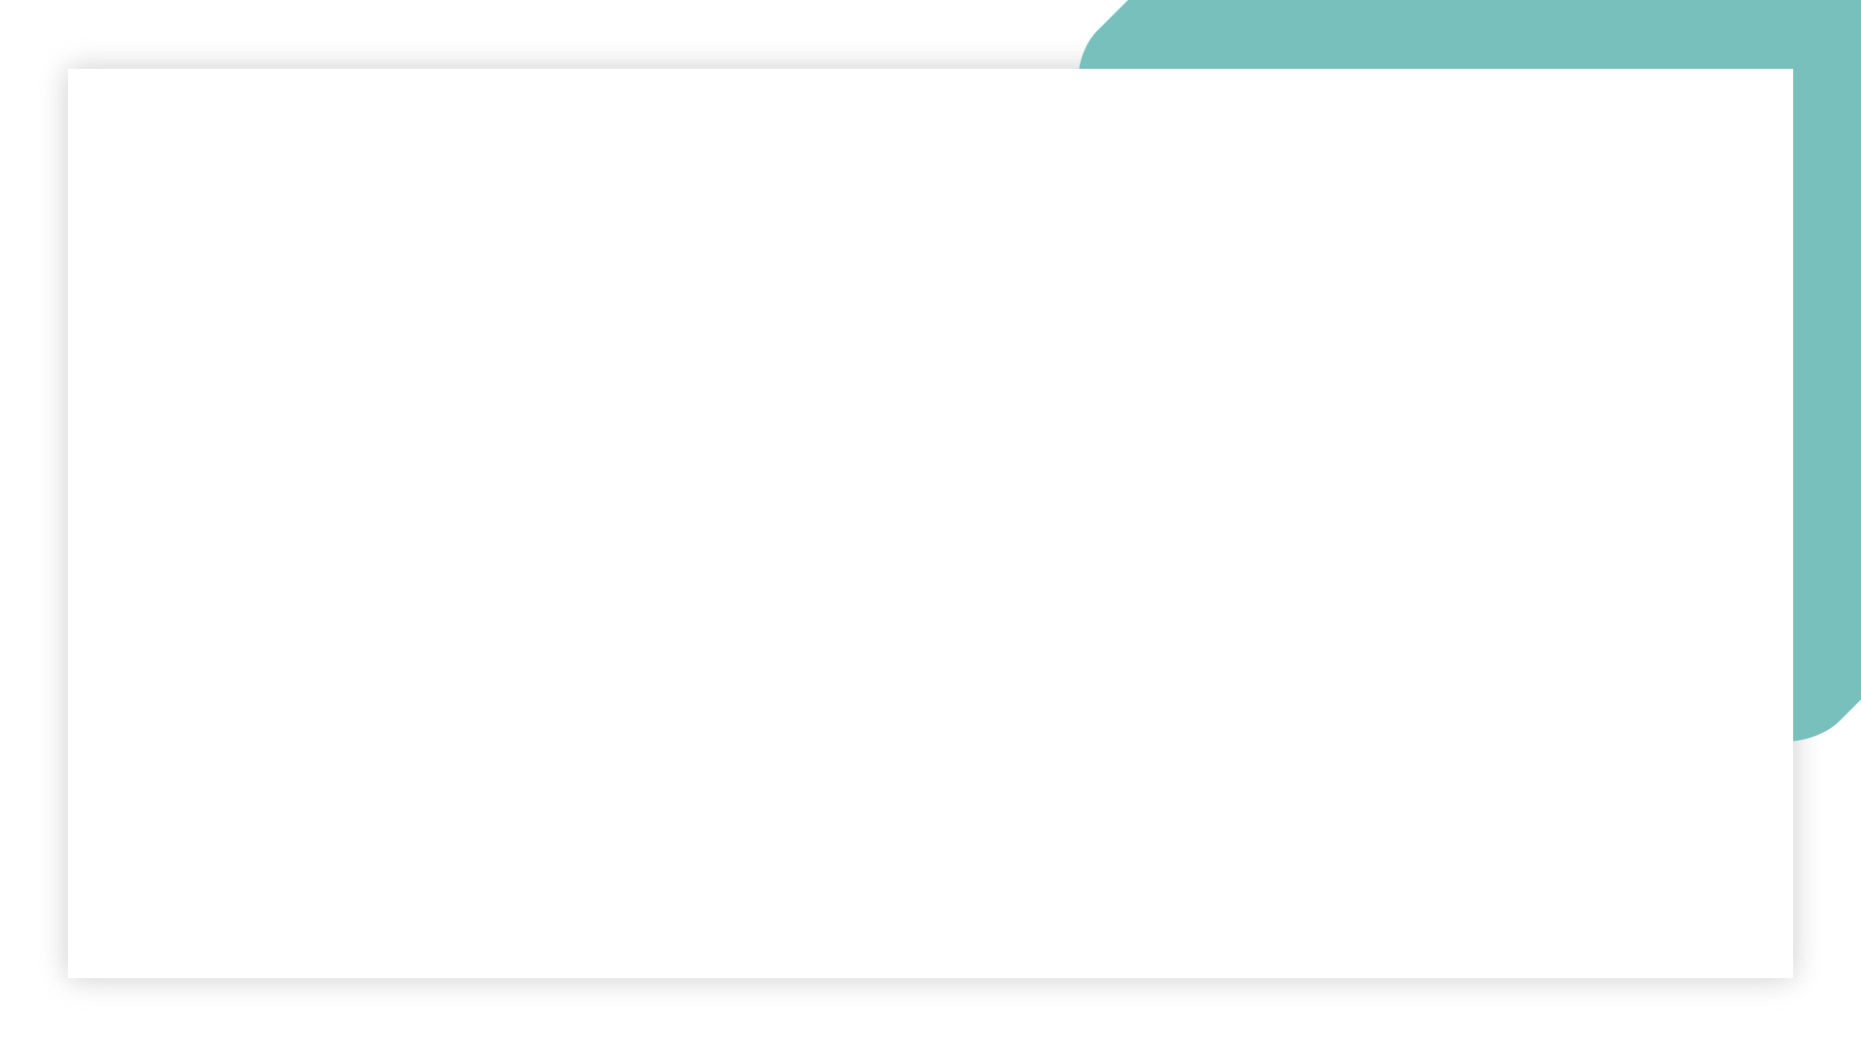
Morning session
Afternoon Session
Lab Session
Guest lecture 1pm
BOG - SQL views /stored procedures
Temporary tables - CA 3.2.3
Examples of self joins
Stretch - Self Joins - w3 schools
Stretch - Cartesian product & cross joins- example with menu
5 min getupanddance break
Self contained sub queries- CA 3.4.4
Sub queries +where -CA 3.5.1,2,3
-fresh air break 20 mins
9:00 kata
break
10am Review of labs
Icebreaker
Break
Window functions - CA 3.2.2
-lunch 12:00 - 13:00
->TA assisted Lab Groups 16:30-
Unit 3 Labs:
stretch - Lab SQL self cross Join
Skip lab on normalisation!
Lab SQL subqueries
Notes:
Introducing this week’s project
Start work on this weeks project

Slide 11
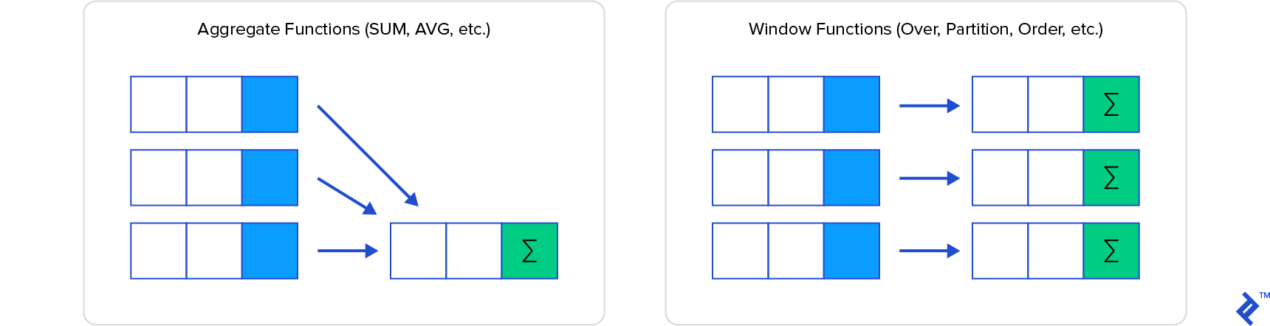
Window functions

Slide 12
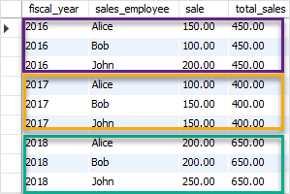
Window functions
Select SUM(sale)
OVER (
Partition BY fiscal_year)
As ‘total_sales’
From salestable
Aggregation eg SUM()
OVER
Partition by fiscal_year
SUM(profit) OVER(PARTITION BY country)

Slide 13
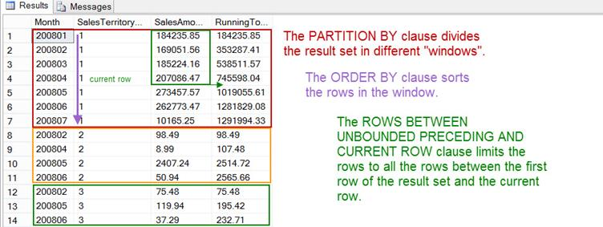
Window functions

Slide 14
Window functions
Window = “Partition” (PARTITION BY) + “Ordering” (ORDER BY) + “Frame” (ROW/RANGE)
OVER defines the set where the function will be applied
OVER (
PARTITION BY -> Divides the set in “chunks” where the function is applied independently (similar to GROUP BY)
ORDER BY -> How to sort the elements within the partition
ROW or RANGE -> Set “boundaries” within each “chunk”
) [AS alias]

Slide 15
IRONHACK BOOTCAMP
WINDOW = PARTITION + ORDER + FRAME
New col
Order
Frame
Partition
Order
Frame
Partition

Slide 16
IRONHACK BOOTCAMP
IRONHACK BOOTCAMP
Next steps : ADDING ORDER TO THE WINDOW
SELECT fruit, size, avg(size) OVER (PARTITION BY fruit ORDER BY fruit DESC) AS Mean_size FROM table
fruit | size
Apple | 34
Apple | 23
Coconut | 15
fruit | size | Mean_size
Coconut | 15 | 15
Apple | 34 | 28.5
Apple | 23 | 28.5

Slide 17
IRONHACK BOOTCAMP
IRONHACK BOOTCAMP
Bank database window functions
select loan_id, account_id, amount, payments, duration, amount-payments as "Balance",
avg(amount-payments) over (partition by duration) as Avg_Balance
from bank.loan
where amount > 100000
order by duration, balance desc;
select loan_id, account_id, amount, payments, duration, amount-payments as "Balance",
avg(amount-payments) over (partition by duration order by duration asc, amounts desc) as Avg_Balance
from bank.loan
where amount > 100000;

Slide 18

‘Hump day’ Wednesday

Slide 19

Morning session
Afternoon Session
Lab Session
Nerdiest tshirt - time to vote!
Common Table Expressions CA 3.06.1
Working with Views CA 3.06.2,3
5 min getupanddance break
Correlated subqueries - intro CA 3.6.4
Fresh air break
Introducing this week’s project
Yoga- chair yoga or …
9:00 morning sunshine
Review /of Labs
Examples of self joins
break
join v subquery
CA 3.05.2
Nested subqueries parent/child
break
Revisit Rank (window fx)
Walk through CA 3.05.3
-lunch 12:30 - 14:00
->TA assisted Lab Groups 16:30-
Unit 3 Labs:
Lab SQL Advanced Queries
(optional) Review / have another go at in class activities from today
Start work on this weeks project

Slide 20
Morning session
Afternoon Session
Lab Session
Nerdiest tshirt - time to vote!
Finish on subqueries
Common Table Expressions CA 3.06.1
Working with Views
5 min getupanddance break
Fresh air break
Introducing this week’s project
yoga
9:00 morning sunshine
Review /of Labs
Examples of self joins
join v subquery
CA 3.05.2
break
Nested subqueries parent/child
Revisit Rank (window fx)
Walk through CA 3.05.3
-lunch 12:30 - 13:30
->TA assisted Lab Groups 16:30-
Unit 3 Labs:
Lab SQL Advanced Queries
(optional) Review / have another go at in class activities from today
Start work on this weeks project
Notes:
Introducing this week’s project
Start work on this weeks project
Stretch - Self Joins - w3 schools
Stretch - Cartesian product & cross joins- example with menu
Correlated subqueries - intro CA 3.6.4
CA 3.06.2,3

Slide 21

Nearly there Thursday

Slide 22

Morning session
Afternoon Session
Lab Session
9:00 SQL quiz with Flo
Review /of Labs
-break-
Time on group project - (1hr -timngs TBC)
Review the Bank case study- outline of afternoon goals
Demo - analysing customer behaviour in Bank data with SQL queries
-lunch 12:30 - 14:00
Demo - analysing customer behaviour in Bank data with SQL queries ( CA 3.07.1,2,3)
-yoga break-
Review of machine learning end to end workflow
EDA and pre processing
How to use classification models to predict customer status (cont friday)
Binary v multi class classification
Using logistic regression
->TA assisted Lab Groups 16:15-
Unit 3 Labs:
Lab 7 - SQL rolling calculations
Lab 8 - Making predictions with logistic regression (to be continued in tomorrow’s Lab session)
Continue work on this week’s group project
Notes:
Continue tomorrow

Slide 23
Bank Customer Analysis: What are we trying to find out?
Bank contains data about customer loans, repayments and status, as well as some customer demographics
Overall TASKs are:
Identify the good clients to whom we can offer other services
Identify the bad clients that have to watch carefully to minimize the losses
Can I use SQL to analyse customer behaviour and start identifying good/ bad customers? What about identifying any problems that the Bank has in general ?
Notes:
Whats your sql comfort zone - kahoot quiz
Project time

Slide 24
Bank Customer Analysis: What are we trying to find out?
Problem # 1 = Customer Churn / attrition
Let’s find out month to month, how many customers were doing transactions.
Tool = LAG function
Approach - create a View, use CTE where useful
https://www.sqlservertutorial.net/sql-server-window-functions/sql-server-lag-function/
Notes:
Whats your sql comfort zone - kahoot quiz
Project time

Slide 25
Bank Customer Analysis: What are we trying to find out?
Problem # 1 = Customer Churn / attrition
Let’s find out how many customers keep doing transactions
the next month, that they did in previous months
Tool = self join
Approach - create a View
https://www.sisense.com/blog/use-self-joins-to-calculate-your-retention-churn-and-reactivation-metrics/
Notes:
Whats your sql comfort zone - kahoot quiz
Project time

Slide 26
Bank Customer Analysis: What are we trying to find out?
Problem # 1 = Customer Churn / attrition
Let’s figure out the difference of ‘active’ users month to month, ie how many more ‘active’ customers this month than last month
Tool = window function for a rolling difference
Approach - subquery
https://www.sisense.com/blog/use-self-joins-to-calculate-your-retention-churn-and-reactivation-metrics/
Notes:
Whats your sql comfort zone - kahoot quiz
Project time

Slide 27

TFI Friday

Slide 28

Title of the slide / Yellow background

Slide 29


